Slide 1
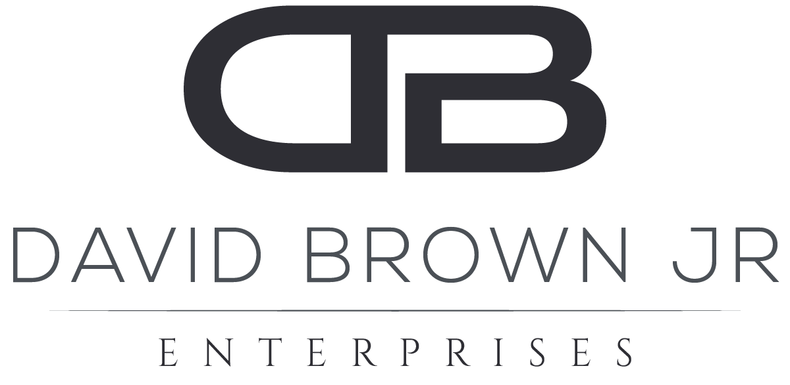
Managing Your Social Impact Career…Authentically
November 18, 2021

Slide 2
We are living in unprecedented times of change…
Global COVID-19 pandemic
Remote and hybrid work is becoming the norm
The Great Resignation is happening
Diversity, equity & inclusion are top of mind for corporate leaders
Equitable compensation is a focus area
All of these events are impacting large groups of people and will be catalysts for how organizations attract, develop and retain talent
Notes:
Provide overview of goals of the presentation
2

Slide 3
How do you define success?
Notes:
Get feedback from the group
Discuss the concept of being “true to self” – has attempted to be understood for centuries. We’ve seen evidence in disciplines such as literature, religion, psychology and business.
3

Slide 4
DBJ’s early career experience
I charted a linear path towards executive leadership
¹ Pre-2013
Notes:
Share brief history of my academic and professional career…focus on linear (cause and effect) lens of the world and how that changed after my MBA and experience of adversity. New perspective and coaching outcomes led me to pursue doctoral degree and ground my understanding in research. This was my introduction to the term “authenticity”.
4

Slide 5
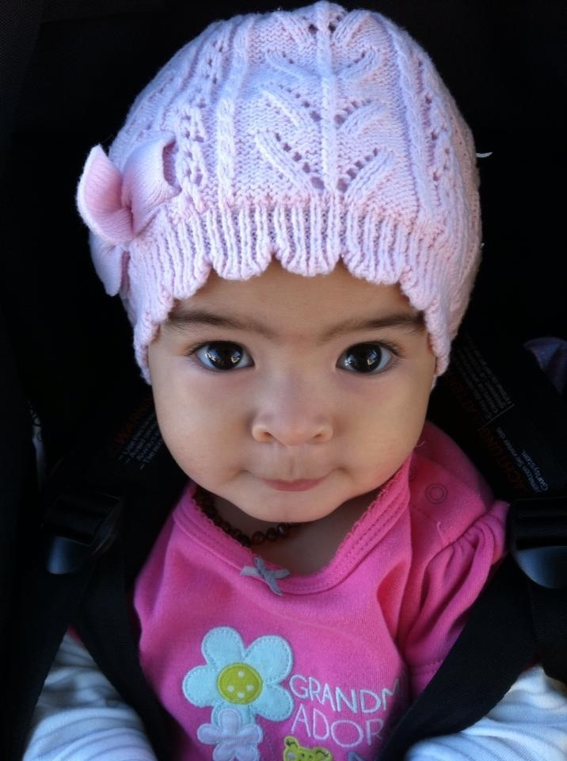
My catalyst for change…my daughter, Leyla
Notes:
Get feedback from the group
Discuss the concept of being “true to self” – has attempted to be understood for centuries. We’ve seen evidence in disciplines such as literature, religion, psychology and business.
5

Slide 6
DBJ’s most recent career experience
My personal tragedy opened me up to seeing life through a lens of interconnected systems
² Post-2013
The big epiphany was that my personal and professional selves were one in the same – this was foundational for realizing my own “authenticity”
Notes:
Share brief history of my academic and professional career…focus on linear (cause and effect) lens of the world and how that changed after my MBA and experience of adversity. New perspective and coaching outcomes led me to pursue doctoral degree and ground my understanding in research. This was my introduction to the term “authenticity”.
6

Slide 7
Key lessons from my experiences
My early career journey was a very “prescribed” way of operating
Who I was personally was never a factor in my development
Cause and effect mentality created limitations and was a dissatisfier
Early on, I defined success by the titles I held and how much money I made (there was never enough!)
Eventually, I integrated who I truly was into the work I was doing, and I realized I didn’t fit the environments I was operating in. But ALL of my experiences have served me.
My sense of personal and professional fulfillment has significantly increased in recent years – my barometer of success is different
“You can’t escape who you truly are”
Notes:
Provide overview of goals of the presentation
7

Slide 8
In your opinion, what does it mean to be authentic?
Notes:
Get feedback from the group
Discuss the concept of being “true to self” – has attempted to be understood for centuries. We’ve seen evidence in disciplines such as literature, religion, psychology and business.
8

Slide 9
“Be true to thine own self”
- Socrates
Notes:
Get feedback from the group
Discuss the concept of being “true to self” – has attempted to be understood for centuries. We’ve seen evidence in disciplines such as literature, religion, psychology and business.
9

Slide 10
A brief history of authenticity and authentic leadership
Interest by both academics and practitioners
Gardner and Avolio key academics
Early origins started with Bill George (former CEO Medtronic) – centered on moral and ethical decision-making (post Enron crisis)
Rising research focus from 1997 to 2010 with a peak in 2005 (91 total journal articles)
Four key attributes of authentic leaders (Kernis, 2003) & (Kernis and Goldman, 2006)
Awareness (knowledge and trust in one’s thoughts, feelings, motives and values)
Unbiased processing (objectivity about and acceptance of one’s positive and negative attributes)
Behavior (acting on one’s true preferences)
Relational orientation (valuing truth and openness in close relationships)
Inconsistent definitions of authentic leadership (13 in total) has stalled theoretical development, which influences practical application
Lehman et al. (2019) produced comprehensive summary of all authenticity research
My research goal was to decouple authenticity from leadership and develop a model that improves our understanding of authenticity in the context of leadership. Additional outcomes included three definitions of authenticity: 1) individual, 2) collective and 3) manifested
Notes:
Share brief synopsis of authenticity and leadership from a research perspective. There has been interest in both the academic and practitioner arena. Explain why I decoupled authenticity from leadership in my research…emphasizing the importance of context. Context builds on my systems knowledge…”no solution is free of context”.
10

Slide 11
Defining the First Level of Authenticity – “Individual Authenticity”
The level of alignment between our internal thoughts, values & beliefs and our actions and behaviors determines our authenticity. We are always authentic, but to varying degrees.
Lower authenticity
“Baseline” authenticity
Higher authenticity
Internal thoughts, values & beliefs
Internal thoughts, values & beliefs
Internal thoughts, values & beliefs
This distance determines level of individual authenticity
External actions & behaviors
External actions & behaviors
External actions & behaviors
Low
Authenticity Continuum
High
Notes:
11

Slide 12
Defining the Second Level of Authenticity – “Collective Authenticity”
Like individuals, groups have their own authenticity based on shared thoughts, values and beliefs. Association with these groups influences the individual’s level of authenticity.
Individual authenticity
Collective authenticity
Internal thoughts, values & beliefs
This distance determines level of leader’s alignment to the collective.
Shared thoughts, values & beliefs
Individual’s relationship to self – CONSISTENCY
Individual’s relationship to others – CONFORMITY
External actions & behaviors
Expected actions & behaviors
“I determine my own level of authenticity.”
“Members of the group determine my level of authenticity.”
Notes:
Explain how collective authenticity is developed through shared thoughts, values and beliefs and shared expectations of actions and behaviors.
The measurement of authenticity at an individual and collective level are different….individual is about your own consistency…and you as the experiencer determine your own level of authenticity (because only you have a lens into your internal thoughts, values and beliefs. Outsiders only see your actions and behaviors). Collective authenticity is about conformity. Members of the group determine whether you fit or not…hence, they judge your level of authenticity.
When these two levels of authenticity are not in alignment, we experience resistance.
12

Slide 13
So, how can we apply authenticity to managing your career?
Alignment of individual and collective authenticity is critical for feeling good about what you do everyday – BE TRUE TO YOU!
Higher authenticity will lead to better performance (HIGHER production, HIGHER creativity, HIGHER trust, HIGHER engagement, LESS energy exertion)
Doing work that connects to something bigger than you creates a sense of purpose
Research on Purpose-Fit shows higher employee satisfaction
Note: having requisite knowledge, skills and abilities (KSAs) is still important when finding the right career opportunities. It’s just not as important as feeling authentic.
Notes:
Share brief synopsis of authenticity and leadership from a research perspective. There has been interest in both the academic and practitioner arena. Explain why I decoupled authenticity from leadership in my research…emphasizing the importance of context. Context builds on my systems knowledge…”no solution is free of context”.
13

Slide 14
Here are a few tips and suggestions for navigating your career authentically
Notes:
Get feedback from the group
Discuss the concept of being “true to self” – has attempted to be understood for centuries. We’ve seen evidence in disciplines such as literature, religion, psychology and business.
14

Slide 15
1. Take inventory of what does and doesn’t feel good
Notes:
Individuals feel resistance. They feel like they don’t fit in.
Provide examples of people feeling like they don’t fit…1) Mark is building a team…some members have worked with Mark in the past. They develop a rhythm. There is an understanding of shared thoughts, values and beliefs. And you know it works because the group is coming back together for this new assignment. Now, Mark is bringing new members to the team. And those members have come from different organizations and backgrounds. They bring their own experience and have to determine how to integrate. Some assimilate and adopt the shared thoughts, values and beliefs. Others will shape the existing thoughts, values and beliefs. As a result, the group operates differently. 2) Lisa has a focus on D,E & I. The root issue that people experience is explained by this relationship. If the culture (i.e shared thoughts, values and beliefs) of an organization feel highly masculine, then women (as an example) may have a hard time adapting to that behavior if they don’t share the same values. The same is true for people of color or members of the LGBTQ community. If you don’t see your own values present in the fabric of the organization, it becomes difficult to assimilate.
15

Slide 16
2. Pursue what makes your heart sing!
Notes:
Individuals feel resistance. They feel like they don’t fit in.
Provide examples of people feeling like they don’t fit…1) Mark is building a team…some members have worked with Mark in the past. They develop a rhythm. There is an understanding of shared thoughts, values and beliefs. And you know it works because the group is coming back together for this new assignment. Now, Mark is bringing new members to the team. And those members have come from different organizations and backgrounds. They bring their own experience and have to determine how to integrate. Some assimilate and adopt the shared thoughts, values and beliefs. Others will shape the existing thoughts, values and beliefs. As a result, the group operates differently. 2) Lisa has a focus on D,E & I. The root issue that people experience is explained by this relationship. If the culture (i.e shared thoughts, values and beliefs) of an organization feel highly masculine, then women (as an example) may have a hard time adapting to that behavior if they don’t share the same values. The same is true for people of color or members of the LGBTQ community. If you don’t see your own values present in the fabric of the organization, it becomes difficult to assimilate.
16

Slide 17
3. Understand the picture may not always be CLEAR
Notes:
Individuals feel resistance. They feel like they don’t fit in.
Provide examples of people feeling like they don’t fit…1) Mark is building a team…some members have worked with Mark in the past. They develop a rhythm. There is an understanding of shared thoughts, values and beliefs. And you know it works because the group is coming back together for this new assignment. Now, Mark is bringing new members to the team. And those members have come from different organizations and backgrounds. They bring their own experience and have to determine how to integrate. Some assimilate and adopt the shared thoughts, values and beliefs. Others will shape the existing thoughts, values and beliefs. As a result, the group operates differently. 2) Lisa has a focus on D,E & I. The root issue that people experience is explained by this relationship. If the culture (i.e shared thoughts, values and beliefs) of an organization feel highly masculine, then women (as an example) may have a hard time adapting to that behavior if they don’t share the same values. The same is true for people of color or members of the LGBTQ community. If you don’t see your own values present in the fabric of the organization, it becomes difficult to assimilate.
17

Slide 18
4. Don’t walk….RUN through doors that open easily!
Notes:
Individuals feel resistance. They feel like they don’t fit in.
Provide examples of people feeling like they don’t fit…1) Mark is building a team…some members have worked with Mark in the past. They develop a rhythm. There is an understanding of shared thoughts, values and beliefs. And you know it works because the group is coming back together for this new assignment. Now, Mark is bringing new members to the team. And those members have come from different organizations and backgrounds. They bring their own experience and have to determine how to integrate. Some assimilate and adopt the shared thoughts, values and beliefs. Others will shape the existing thoughts, values and beliefs. As a result, the group operates differently. 2) Lisa has a focus on D,E & I. The root issue that people experience is explained by this relationship. If the culture (i.e shared thoughts, values and beliefs) of an organization feel highly masculine, then women (as an example) may have a hard time adapting to that behavior if they don’t share the same values. The same is true for people of color or members of the LGBTQ community. If you don’t see your own values present in the fabric of the organization, it becomes difficult to assimilate.
18

Slide 19
5. Be comfortable with…
Notes:
Individuals feel resistance. They feel like they don’t fit in.
Provide examples of people feeling like they don’t fit…1) Mark is building a team…some members have worked with Mark in the past. They develop a rhythm. There is an understanding of shared thoughts, values and beliefs. And you know it works because the group is coming back together for this new assignment. Now, Mark is bringing new members to the team. And those members have come from different organizations and backgrounds. They bring their own experience and have to determine how to integrate. Some assimilate and adopt the shared thoughts, values and beliefs. Others will shape the existing thoughts, values and beliefs. As a result, the group operates differently. 2) Lisa has a focus on D,E & I. The root issue that people experience is explained by this relationship. If the culture (i.e shared thoughts, values and beliefs) of an organization feel highly masculine, then women (as an example) may have a hard time adapting to that behavior if they don’t share the same values. The same is true for people of color or members of the LGBTQ community. If you don’t see your own values present in the fabric of the organization, it becomes difficult to assimilate.
19

Slide 20
“Designing your career and designing your life are one in the same. Choosing to treat them as mutually exclusive is choosing a limiting perspective.”
Notes:
Shifting a person’s level of individual authenticity is a deeply personal experience because you are dealing with how people think, what they value and what they believe. As they change individually, their participation and experience as part of some collective group, changes the group. As a result, the system begins to change. It starts at an individual level and builds from there. Authenticity is an inward-out journey….not outward-in.
20

Slide 21
Q & A
Notes:
Ask the question to the audience and gather responses
21

Slide 22
Appendix

Slide 23
References
¹https://www.reddit.com/r/FortniteCompetitive/comments/d9elpe/extreme_breakdown_linear_or_exponential_controller/
²https://www.physiq.com/resources/safe-systems-thinking/
Notes:
23

